Slide 1

Thompson Sampling
Siddharth Ajit and Mason Rumuly
for ECEN 689-606

Slide 2
Outline
Multi-Arm Bandits
Exploration, Exploitation, and Regret
Bernoulli Distribution
The Beta Distribution and Modeling Uncertainty
Sampling Algorithm
Demo
Performance Guarantees
Variants

Slide 3
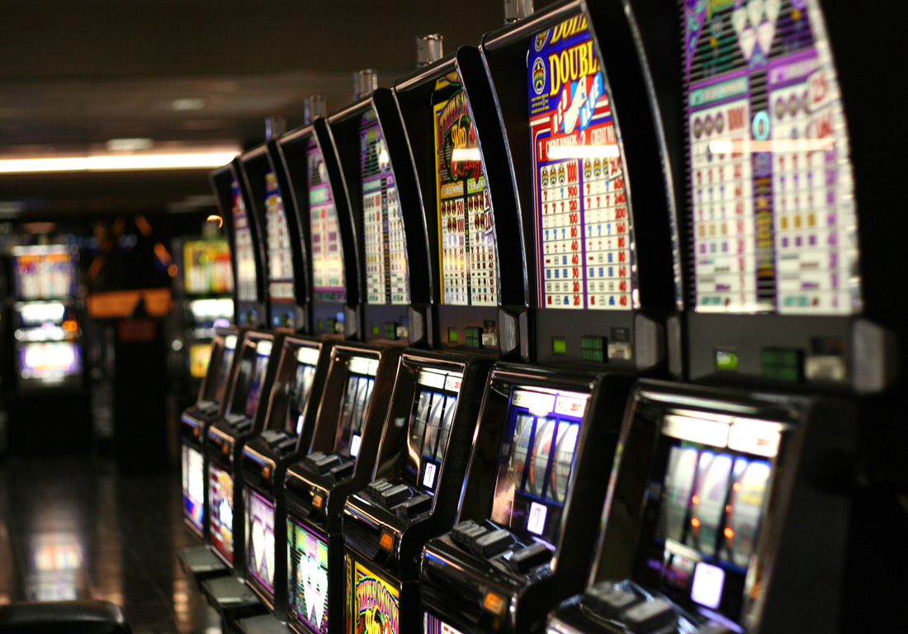
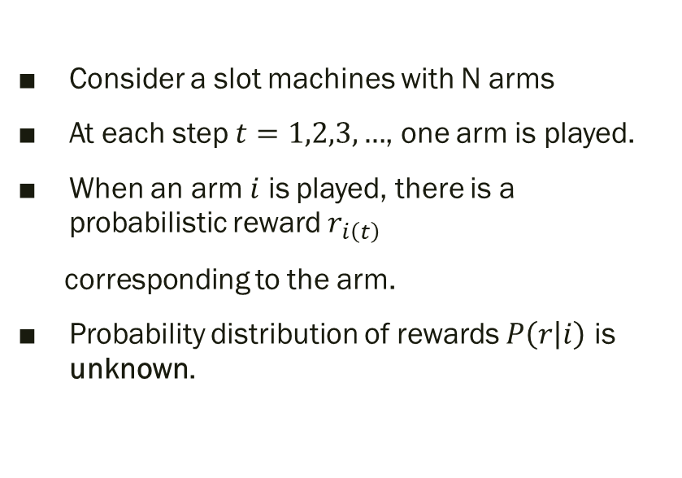
Multi Arm Bandit Problem
Consider a slot machines with N arms
At each step $t=1,2,3,…$, one arm is played.
When an arm $i$ is played, there is a probabilistic reward $r_{i\left(t\right)}$
corresponding to the arm.
Probability distribution of rewards $P\left(r | i\right)$ is unknown.
Notes:
The random reward for a given arm each round is i.i.d and does not depend on the rewards of the other arms.
The reward value is observed as soon as the arm is played

Slide 4
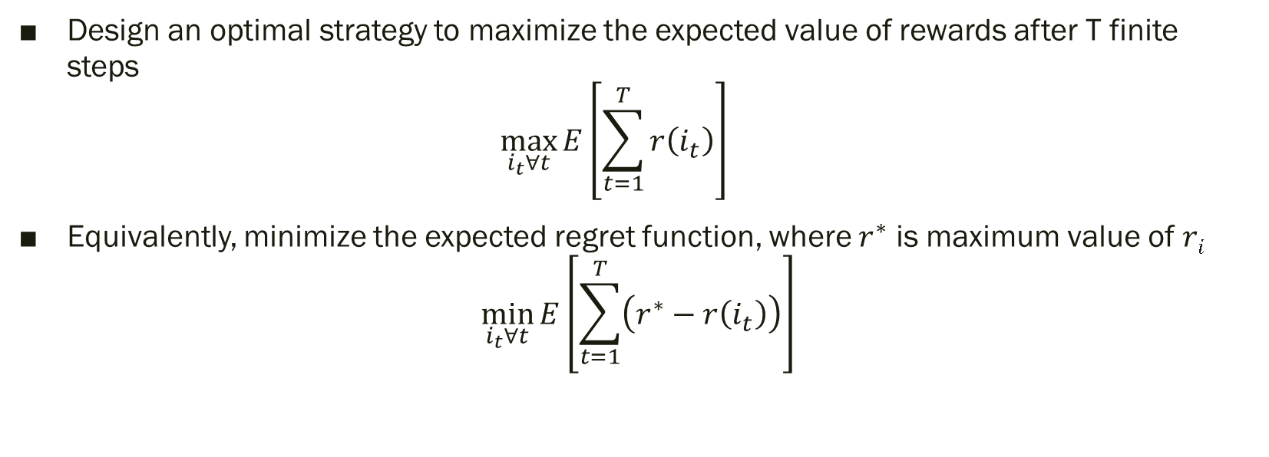
Objective
Design an optimal strategy to maximize the expected value of rewards after T finite steps $\max_{i_{t}∀t}{E\left[\sum_{t=1}^{T}{r\left(i_{t}\right)}\right]}$
Equivalently, minimize the expected regret function, where $r^{∗}$ is maximum value of $ri$
$$\min_{i_{t}∀t}{E\left[\sum_{t=1}^{T}{\left(r^{∗}−r\left(i_{t}\right)\right)}\right]}$$

Slide 5
General MAB Summary
To summarize, the MAB problem is a finite resource allocation problem where the objective is to maximize total returns.
The return of each choice is unknown or only partially known beforehand
The agent accumulates knowledge about the bandit as it takes actions

Slide 6
MAB Examples
Financial investment
Clinical trials
Digital advertisements
Notes:
– Given a fixed amount of cash flow, what is the optimal policy to maximize the returns over a period of time.
– Find the best possible treatment option from many other possible options while minimizing harmful effects for the patient.
– Choose the advertisement which gets the most clicks given your website traffic

Slide 7
Exploration and Exploitation
Exploration : Gain or learn more information about the rewards by pulling all the arms
Exploitation : Maximize the reward or minimize the regret by pulling the arms with greatest expected value
In the context of MAB, the user must take action (play an arm) to learn about it. In short, sub optimal actions should be chosen to maximize long term benefits.
Notes:
; gather more information to improve future decisions.
; Make the best decision given the existing information.

Slide 8
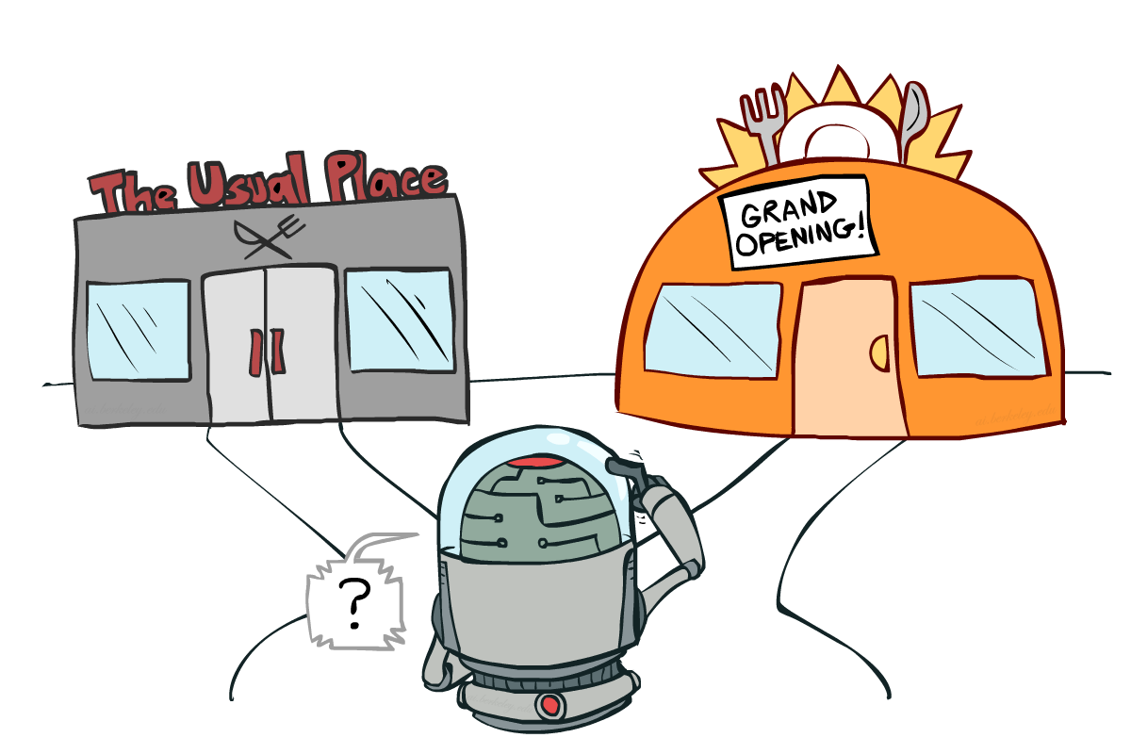
Example
Notes:
Explore : Visit the new restaurant to learn about it. You may like the new place and hopefully visit it more often or regret your decision
Exploit : Go to the usual favorite restaurant and “exploit” the utility or value associated with the decision. You may lose out on finding a better restaurant

Slide 9
MAB problem strategies
No exploration : A naïve approach, often yields sub-optimal results
Exploration at random
Algorithmic exploration
ϵ -Greedy Selection
UCB arm selection
Thompson sampling
Etc.

Slide 10

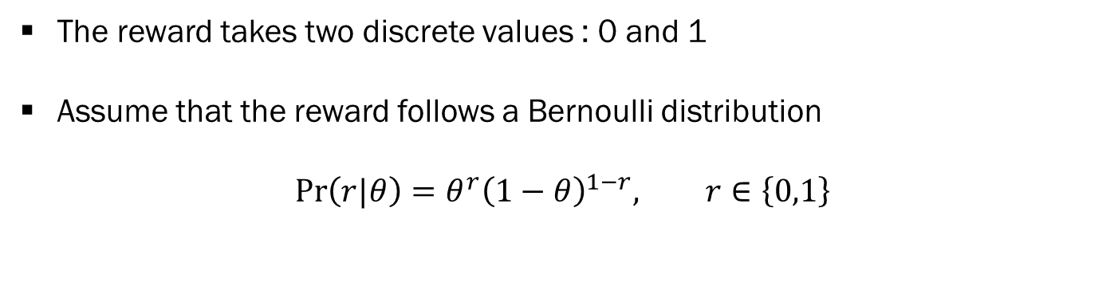
Demo MAB Case
P1
P2
P3
The reward takes two discrete values : 0 and 1
Assume that the reward follows a Bernoulli distribution
$$\operatorname{Pr}\left(r|θ\right)=θ^{r}{\left(1−θ\right)}^{1−r}, r∈\left\{0,1\right\}$$

Slide 11
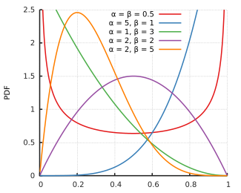
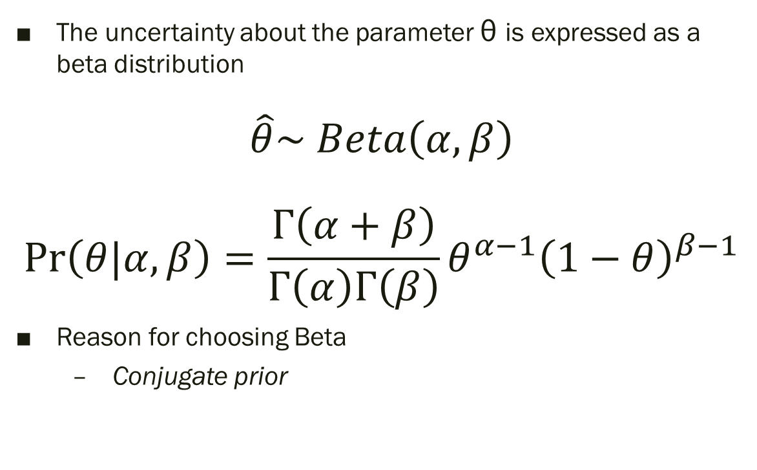
Beta distribution
The uncertainty about the parameter θ is expressed as a beta distribution
$$\hat{θ}\sim Beta\left(α,β\right)$$ $$Pr\left(θ|α,β\right)=\frac{Γ\left(α+β\right)}{Γ\left(α\right)Γ\left(β\right)}θ^{α−1}{\left(1−θ\right)}^{β−1}$$
Reason for choosing Beta
Conjugate prior
Notes:
Bayesian update is computationally tractable

Slide 12
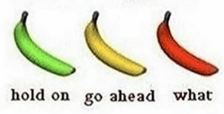
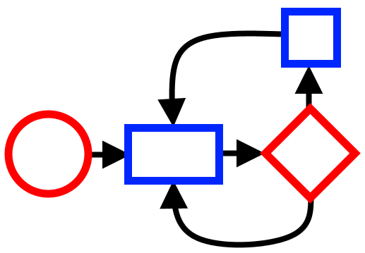
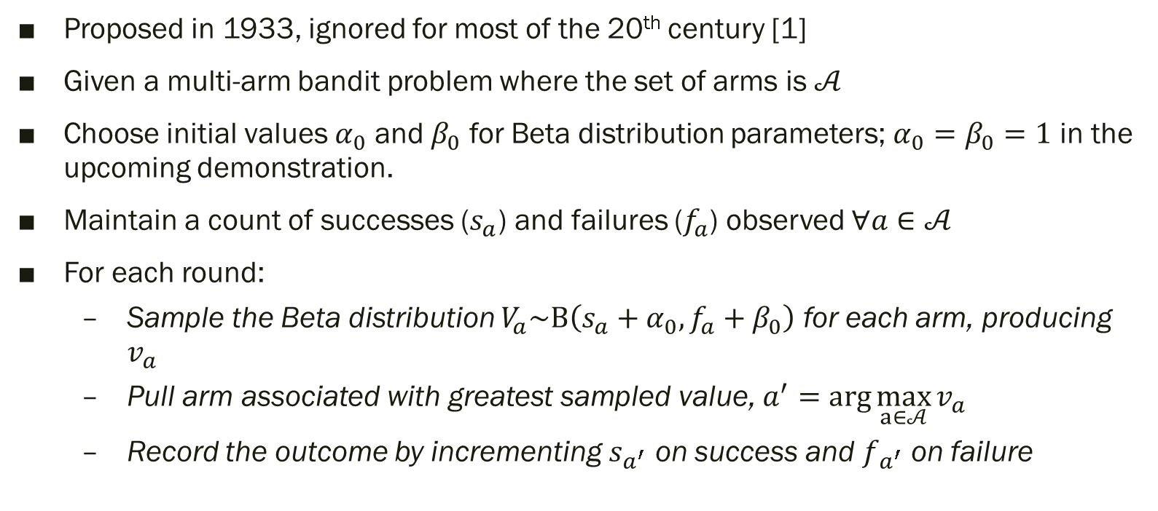
Sampling Algorithm
Proposed in 1933, ignored for most of the 20th century [1]
Given a multi-arm bandit problem where the set of arms is $𝒜$
Choose initial values $α_{0}$ and $β_{0}$ for Beta distribution parameters; $α_{0}=β_{0}=1$ in the upcoming demonstration.
Maintain a count of successes ($s_{a}$) and failures ($f_{a}$) observed $∀a∈𝒜$
For each round:
Sample the Beta distribution $V_{a}\sim Β\left(s_{a}+α_{0},f_{a}+β_{0}\right)$ for each arm, producing $v_{a}$
Pull arm associated with greatest sampled value, $a^{′}=\arg{\max_{a∈𝒜}{v_{a}}}$
Record the outcome by incrementing $s_{a^{′}}$ on success and $f_{a^{′}}$ on failure

Slide 13

Demo
Open the associated IPython notebook for an interactive demonstration of Thompson Sampling

Slide 14
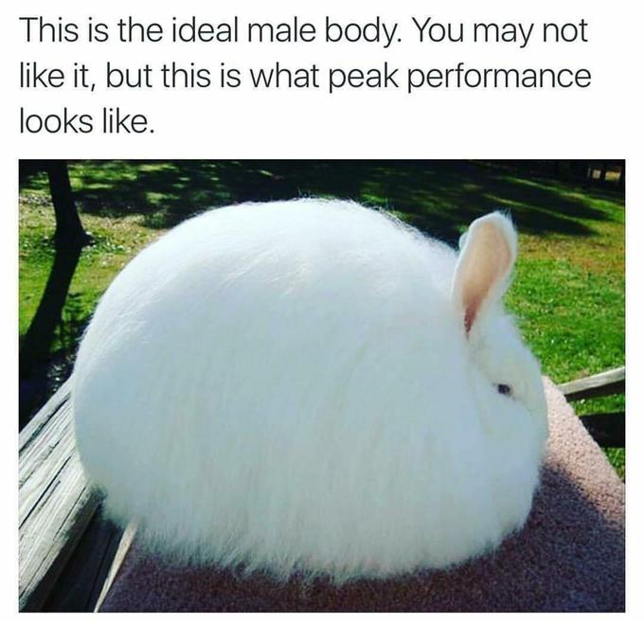

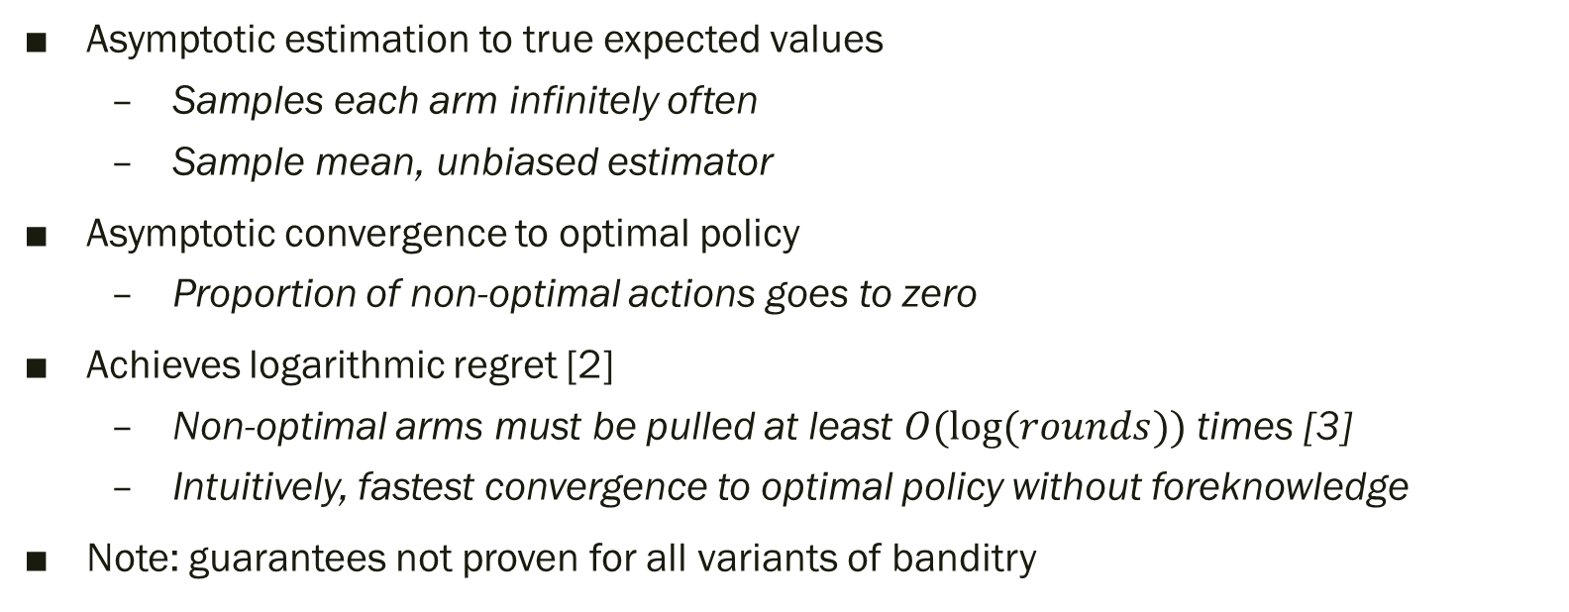
Performance Guarantees
Asymptotic estimation to true expected values
Samples each arm infinitely often
Sample mean, unbiased estimator
Asymptotic convergence to optimal policy
Proportion of non-optimal actions goes to zero
Achieves logarithmic regret [2]
Non-optimal arms must be pulled at least $O(log⁡(rounds))$ times [3]
Intuitively, fastest convergence to optimal policy without foreknowledge
Note: guarantees not proven for all variants of banditry

Slide 15
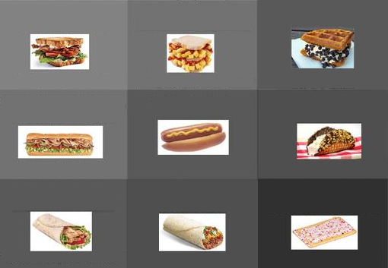
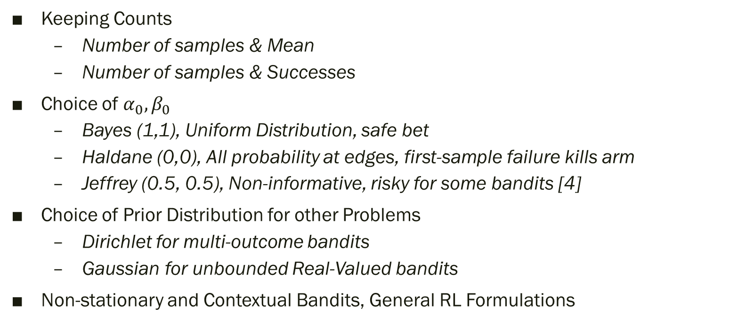
Variants
Keeping Counts
Number of samples & Mean
Number of samples & Successes
Choice of $α_{0},β_{0}$
Bayes (1,1), Uniform Distribution, safe bet
Haldane (0,0), All probability at edges, first-sample failure kills arm
Jeffrey (0.5, 0.5), Non-informative, risky for some bandits [4]
Choice of Prior Distribution for other Problems
Dirichlet for multi-outcome bandits
Gaussian for unbounded Real-Valued bandits
Non-stationary and Contextual Bandits, General RL Formulations

Slide 16
Summary
Multi-Arm Bandits
Exploration, Exploitation, and Regret
Bernoulli Distribution
The Beta Distribution and Modeling Uncertainty
Sampling Algorithm
Demo
Performance Guarantees
Variants

Slide 17
References
[1] Thompson, William R. "On the likelihood that one unknown probability exceeds another in view of the evidence of two samples". Biometrika, 25(3–4):285–294, 1933.
[2] Kaufmann, E., Korda, N., & Munos, R. “Thompson Sampling: an Asymptotically Optimal Finite-Time Analysis”. Proceedings of the 23rd international conference on Algorithmic Learning Theory (ALT’12) , pp. 199-213. 2012.
[3] Lai, T.L., & Robbins, H. “Asymptotically Efficient Adaptive Allocation Rules”. Advances in applied Mathematics, 6, pp 4-22, 1985.
[4] Junya Honda, Akimichi Takemura.“Optimality of Thompson Sampling for Gaussian Bandits Depends on Priors”. Proceedings of the Seventeenth International Conference on Artificial Intelligence and Statistics, PMLR 33:375-383, 2014.

